Slide 1
Reasoning
November 14, 2018

Slide 2
Reasoning
_x0010_ Definition: Mental processes by which people derive conclusions from a given set of premises.
E.g. Saturday is the day after Friday - premise
Today is Friday - premise
Tomorrow will be Saturday - conclusion
Two types of reasoning:
Inductive reasoning + Deductive reasoning

Slide 3


Reasoning
Inductive Reasoning involves deciding what is probably the case based on one’s knowledge
E.g. Every morning in the past the sun has risen
in the east.
Therefore the sun will rise in the east tomorrow.
E.g. of a turkey’s inductive reasoning
I have been fed every day up to today (23rd Dec)
Therefore I will be fed tomorrow (24th Dec)
TRUE
In inductive reasoning, when the premises are true, the conclusion is not necessarily true. The conclusion can only be judged true with a certain degree of probability.
FALSE

Slide 4
Reasoning
Deductive Reasoning involves conclusions that follow with certainty from the premises.
E.g.
Premise - If it is raining, the ground outside will be wet.
Premise - It is raining.
conclusion - Therefore the ground outside is wet.

Slide 5
Inductive Reasoning
We use inductive reasoning all the time to make decisions about the world
E.g.
It is getting cloudy and dark, its probably going to rain
If I flick the light switch, the light will come on
If I don’t eat something I’ll get hungry

Slide 6
Inductive Reasoning
Inductive reasoning results in a hypothesis.
Testing a hypothesis will result in either confirmation or falsification
Confirmation involves finding evidence is support of the hypothesis.
Falsification involves finding evidence that does not support the conclusions.

Slide 7
Inductive Reasoning
Confirmation Bias:
People tend to test hypotheses by seeking confirming evidence rather than by attempting falsification of the hypothesis.
Confirmation bias is observed for both ordinary people and professional scientists (Tweney, 1998) even though falsification can be regarded as what distinguishes science from unscientific activities (Popper, 1968)

Slide 8
Inductive Reasoning
Confirmation Bias:
“The Earth is flat”
Confirmation bias leads to the following test:
It appears flat
Falsification leads to the following test:
If one sails westward for long enough
they will arrive back home from the east

Slide 9
Inductive Reasoning
Confirmation bias is evident in peoples social thinking
Stereotyping: “All skinheads are violent”
People are very good at remembering instances that support these judgements
People tend to neglect instances which do not support these judgements

Slide 10
The 2-4-6 task
Wason (1960) investigated strategies used by people when testing hypotheses
Participants were told that there was a general rule for grouping 3 numbers
As an example they were told that ‘2-4-6’ conforms to the rule
They had to suggest examples in order to discover what the rule might be.

Slide 11
The 2-4-6 task
People were coming up with a hypothesis:
“The rule is ascending in twos”
They tended to come up with suggestions that confirmed this rule.
“What about 5-7-9. What about 20-22-24”
These all conformed so they believed their hypothesis to be true
In fact, the best was to test a hypothesis is to try to falsify it
“What about 6-8-9”
Doing this leads to discovery of the rule.

Slide 12
The 2-4-6 task
Therefore the following would all conform
4-6-8
1-3-7
100-150-200
The actual rule: Three numbers ascending in value
People were generally bad at discovering the actual rule. 28% failed to discover it at any stage.

Slide 13
The 2-4-6 task
Klayman & Ha (1987) arguement:
The difficulty with the 2-4-6 task is that it possesses the unusual characteristic that the correct rule is much more general than any of the initial hypotheses that participants are likely to form.
As a result, positive testing cannot lead to discovery of the correct rule, and negative testing is required

Slide 14
The 2-4-6 task
Tweney (1980)
Modified Version: Find two rules rather than one rule.
DAX, “three ascending numbers” (i.e. Wason’s original rule)
MED, any other triple (i.e. does not obey the DAX rule).
Each time a triplet of numbers was suggested by participants, they were told that it was either a DAX or a MED triplet.

Slide 15
The 2-4-6 task
Results:
People were much better at discovering the DAX rule than in Wason’s original study.
No explanation was proposed by Tweney. It shows how the way a task is presented affects how it is tackled, and thus must reveal something about how are reasoning works.

Slide 16
The 2-4-6 task
One explanation (proposed by Evans, 1989) is that people have a positivity bias in their hypothesis testing strategy.
The idea of positivity bias supposes that people are more likely to make positive tests of their hypothesis than negative tests.
Since negative testing is required to find the rule in the original 2-4-6 task, participants’ positivity bias makes this task difficult.
However, the dual goal paradigm allows participants to use positive tests of their hypotheses about the MED rule in order to gather information about the DAX rule.

Slide 17
Deductive Reasoning
Deductive reasoning allows us to draw conclusions that are definitely valid provided that the other statements are assumed to be true.
Conditional Reasoning:
Premise - If it is raining, the ground outside will be wet.

Slide 18
Deductive Reasoning
Conditional Reasoning involves deciding something based on knowledge about something else.
Reasoning based on if and then
If it is raining, then the ground outside will be wet.
Premise - It is raining
Conclusion - Therefore the ground outside is wet.
A
B

Slide 19
Deductive Reasoning
if A, then B
This rule of inference is known as modus ponens
If B is false, then A is false
If the ground outside is not wet, then it is not raining.
This rule of inference is known as modus tollens
If A is false, then is B false Not Necessarily!
If it is not raining, the ground will not be wet. (can still be wet!)
This is known as denial of the antecedent
If B is true, then is A true Not Necessarily!
If the ground outside is wet, then it is raining. (not necessarily raining)
This is known as affirmation of the consequent

Slide 20
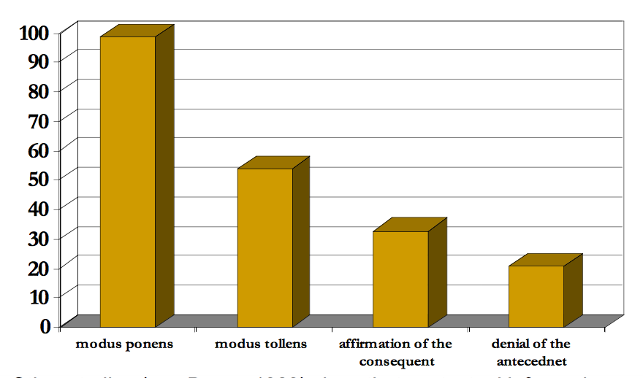
Deductive Reasoning
Premises: If A, then B (If it is raining, then Nancy gets wet.)
B √ | A √ | Affirmation of the consequent | invalid
A √ | B √ | Modus ponens | valid
B × | A × | Modus tollens | valid
A × | B × | Denial of antecedent | invalid
Marcus & Rips (1979)
Percentage of endorsing the various conditional inferences

Slide 21
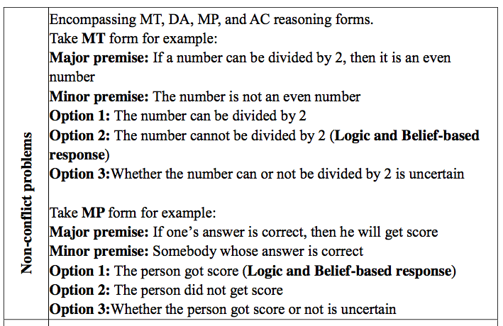
MT-Modus Tollens
DA-Denial of the Antecedent
MP-Modus Ponens
AC-Affirmation of the Consequent
Deductive Reasoning

Slide 22
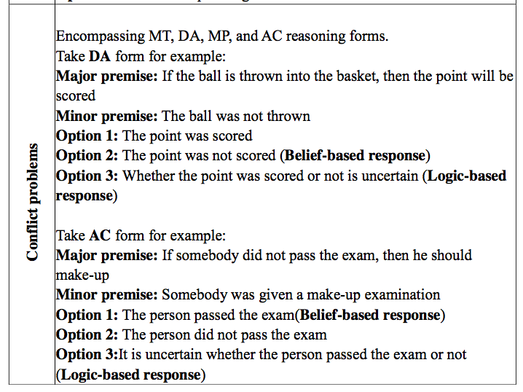
MT-Modus Tollens
DA-Denial of the Antecedent
MP-Modus Ponens
AC-Affirmation of the Consequent
Deductive Reasoning

Slide 23
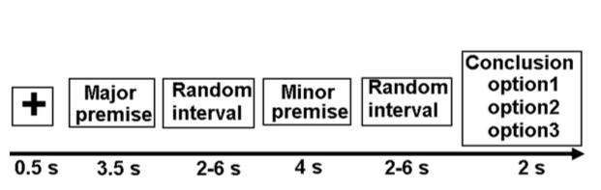

Deductive Reasoning

Slide 24
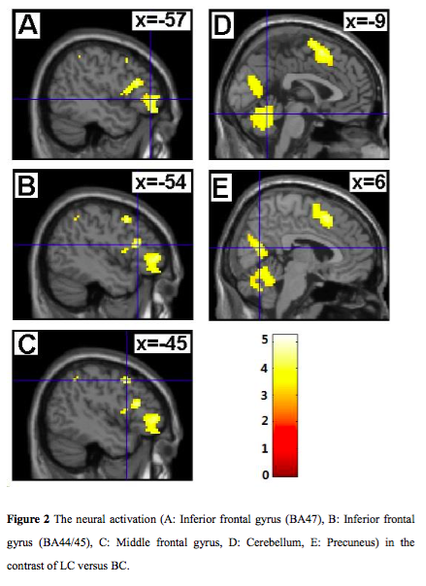
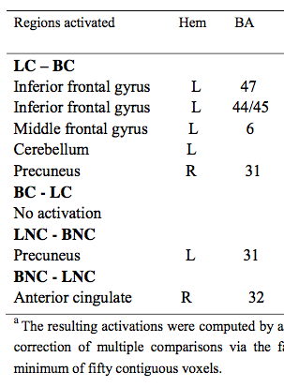

Slide 25
Deductive Reasoning Theories
Abstract Rule Theory
Mental Model Approach

Slide 26
Deductive Reasoning
Abstract Rule Theory
Following processes occur when someone encounters a deductive reasoning problem:
The premises are comprehended and encoded into a mental representation in working memory.
Chinese are playing in a pingpang match. Crowd in pub are watching.
2) Abstract-rule schema’s are applied to these premises in order to derive a conclusion (e.g. modus ponens)
If Chinese do well, the people watching will be happy. Loud cheer!
3) Feeder schemas are applied to produce intermediate conclusions.
I hear a loud cheer during the match.
4) Incompatibility rules examine the contents of working memory for any incompatible references (e.g. inferring both ‘A’ and ‘not A’)
Could there be Japan fans in the pub? Would the be that loud? Could Chinese fans cheer a Japan points because they want the manager to get sacked?

Slide 27
Deductive Reasoning
Abstract Rule Theory
Braine (1984) argued the reasons why people make errors in reasoning:
Comprehension errors: The premises are interpreted incorrectly. (e.g. If there are ripples in the lake then it must be raining)
Heuristic inadequacy: The participants reasoning processes fail to locate the correct line of reasoning. (They fail to see the link between rain and ripples)
Processing errors: The participant fails to attend fully to the task at hand or suffers from memory overload. (Distraction, interruption, not thinking things through)

Slide 28
Deductive Reasoning
Abstract Rule Theory
General assumption:
Normally, people reason correctly provided they don’t misunderstand the premises, get distracted etc.

Slide 29
Deductive Reasoning
Abstract Rule Theory
Reasoning error: Affirmation of the consequent
“There are ripples in the lake” leads incorrectly to the conclusion “It is raining”.
According to Braine et al. (1984) this occurs because of a conversion error
“If it rains, then there are ripples in the lake”
“If there are ripples in the lake, it is raining”
replacement

Slide 30
Deductive Reasoning
Abstract Rule Theory
Braine et al. (1984) argued that there is an assumption amongst people that we are being given certain information for a reason.
“If you mow the lawn, I will give you 5 euro”
“If you don’t mow the lawn, I wont give you 5 euro”
Advertisements
inference

Slide 31
Deductive Reasoning
Abstract Rule Theory
Braine et al. (1984) reduced the likelihood of a conversion error by providing an additional, clarifying premise:
e.g. If it is raining, then Alicia gets wet.
If it is snowing, then Alicia gets wet.
Alicia gets wet.
Conclusion…

Slide 32
Deductive Reasoning
Abstract Rule Theory
Limitations:
‘Comprehension’ component is under specified, so it is hard to make predictions about how well a person will reason.
The theory has only been applied to a limited range of reasoning tasks.
Individual differences are de-emphasised.
There is little convincing evidence that people use mental logic when presented with deductive reasoning problems.

Slide 33



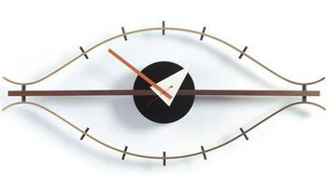

Deductive Reasoning
Mental Models
Proposed by Johnson-Laird (1983, 1999)
A mental model is a possibility for the way things are in the world
E.g. Premises
The lamp is on the right of the pad
The book is on the left of the pad
The clock is in front of the book
The vase is in front of the lamp
Conclusion: The clock is to the left of the vase

Slide 34
Deductive Reasoning
Mental Models
Assumptions:
A mental model describing the given situation is constructed, and the conclusions following from this are generated.
An attempt is made to construct alternative models that will falsify the conclusion.
If a satisfactory alternative model is not found, the conclusion is assumed to be valid.
The construction of mental models taxes the Working Memory system

Slide 35
Deductive Reasoning
Mental Models
Assumptions: …continued
To save Working Memory resources, people tend to construct models that represent explicitly what is true and not what is false. (Model based on “If it rains there will be ripples in the lake”, not on “If there are no ripples in the lake, it is not raining”. This is the Principle of truth.
Problems requiring the construction of mental models are harder to solve than those requiring only one mental model, because of the demands on Working Memory.

Slide 36
Deductive Reasoning
Mental Models
Johnson-Laird (1983) had participants arrive at a conclusion based on premises.
When only 1 model was required 78% drew valid conclusion
When 2 models were required, 29% drew valid conclusion
When 3 models were required 13% drew valid conclusion

Slide 37
Deductive Reasoning
Mental Models
Laird & Goldvarg (1997) showed that participants over-emphasis on the principal of truth led to 99% of participants making the wrong conclusion in a hand of cards task
Only one of the following premises is true about a particular hand of cards.
There is a king in the hand or there is an ace, or both
There is a queen in the hand or there is an ace, or both
There is a jack in the hand or there is a 10, or both
Is it possible that there is an ace in the hand?

Slide 38
Deductive Reasoning
Mental Models
Mental model theory accounts for a wide range of problems and most of its predictions have been confirmed experimentally.
Mental models do not require the existence of ‘mental logic’, but rather the theory requires nothing more than the normal processes of comprehension.
This leads to the argument that the tests used in reasoning experiments can be used to draw conclusions on everyday real life reasoning .

Slide 39
Deductive Reasoning
Mental Models
Limitations:
More details needed as to how mental models are formed and which knowledge we bring forth and use.
Ford (1995) Identified spatial and verbal reasoners.
“Neither…could be said to provide evidence of developing mental models that are structural analogues of the world”

Slide 40
Method of Deductive Reasoning
Examples:
All students eat pizza.
Claire is a student at ASU.
Therefore, Claire eats pizza.
2. All athletes work out in the gym.
Barry Bonds is an athlete.
Therefore, Barry Bonds works out in the gym.

Slide 41
Deductive Reasoning
All math teachers are over 7 feet tall.
Mr. D. is a math teacher.
Therefore, Mr. D is over 7 feet tall.
The argument is valid, but is certainly not true.
The above examples are of the form
If p, then q. (major premise)
x is p. (minor premise)
Therefore, x is q. (conclusion)

Slide 42
Venn Diagrams
Venn Diagram: A diagram consisting of various overlapping figures contained in a rectangle called the universe.
U
This is an example of all A are B. (If A, then B.)
B
A

Slide 43
Venn Diagrams
This is an example of No A are B.
U
A
B

Slide 44
Venn Diagrams
This is an example of some A are B. (At least one A is B.)
The yellow oval is A, the blue oval is B.

Slide 45
Example
Construct a Venn Diagram to determine the validity of the given argument.
  All smiling cats talk.
The Cheshire Cat smiles.
Therefore, the Cheshire Cat talks.
VALID OR INVALID???

Slide 46
Example
Valid argument; x is Cheshire Cat
Things
that talk
Smiling cats
x

Slide 47
Examples
  No one who can afford health insurance is unemployed.
All politicians can afford health
insurance.
Therefore, no politician is unemployed.
VALID OR INVALID?????

Slide 48
Examples
X=politician. The argument is valid.
People who can afford
Health Care.
Politicians
X
Unemployed

Slide 49
Example
Some professors wear glasses.
Mr. Einstein wears glasses.
Therefore, Mr. Einstein is a professor.
Let the yellow oval be professors, and the blue oval be glass wearers. Then x (Mr. Einstein) is in the blue oval, but not in the overlapping region. The argument is invalid.

Slide 50
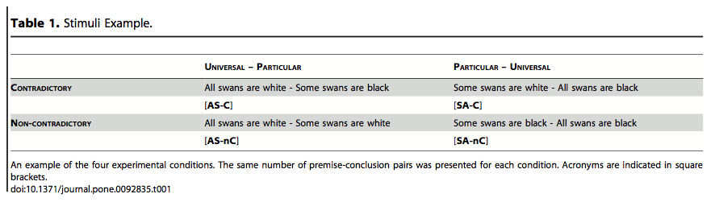
Contradictory Reasoning Network: An EEG and fMRI Study
2014, Plos one
deductive reasoning
Inductive reasoning

Slide 51
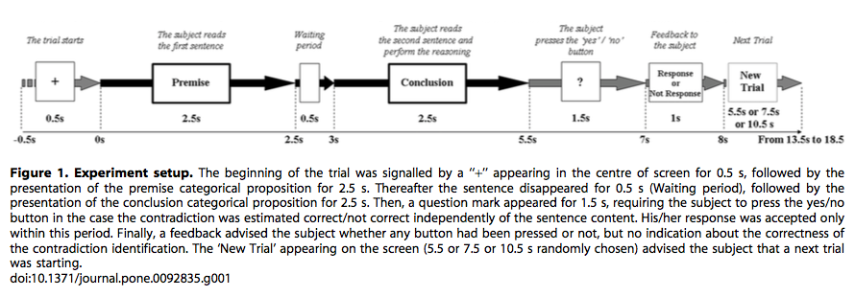
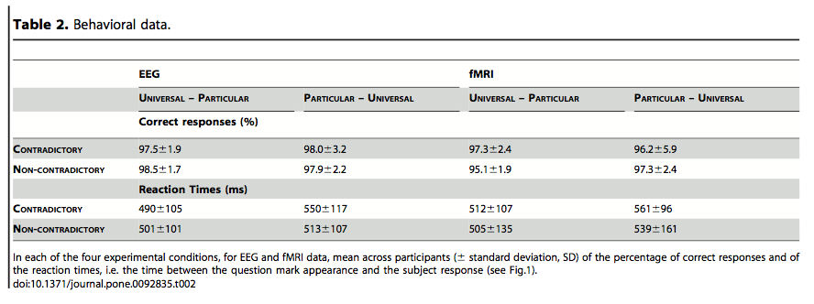
longer reaction times for inductive reasoning, when a UNIVERSAL rule had to be inferred based on an example.
Notes:
The results revealed that participants improved their overall performance along the course of the experiment (Time effect F(3,36) = 15, p,0.001) and were faster to compute AS than SA logical operation (F(3,36) = 9.83, p = 0.011) with no effect of Contradiction.
Importantly, Time did not interact with either of the manipulations (p . 0.200 for both Time* Contradiction and Time*Logical Operator), indicating that participants did not change their strategy during the course of the experiment

Slide 52
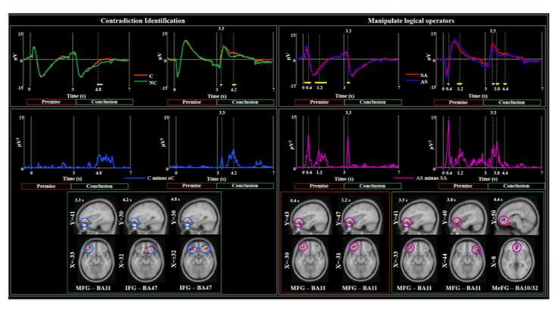
Notes:
Global Field Power

Slide 53
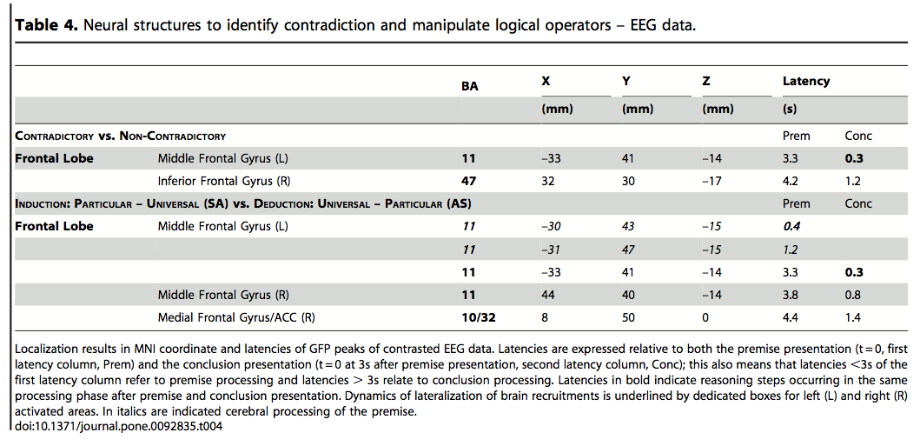

Slide 54
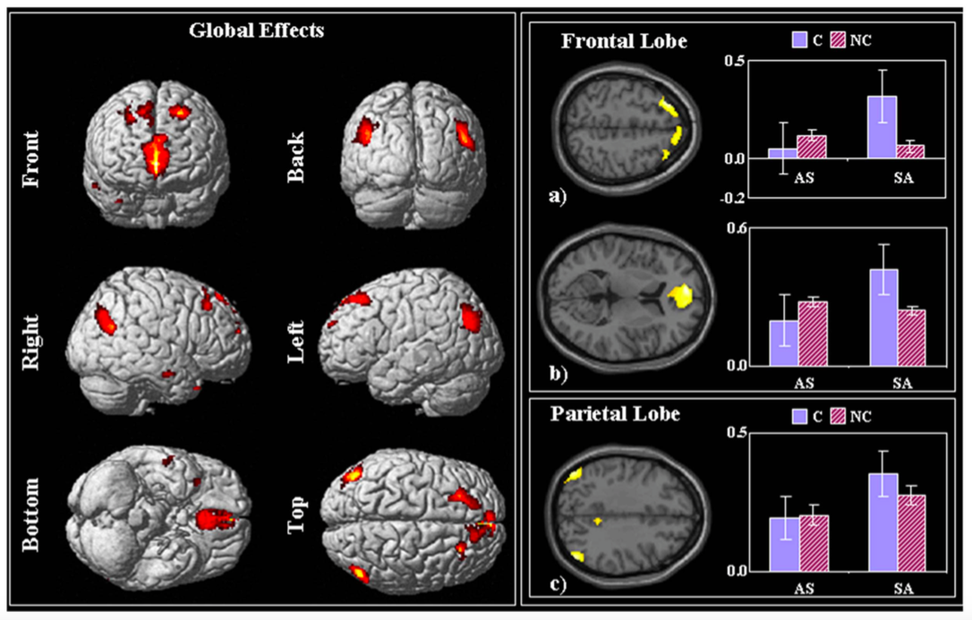
Right superior frontal gyrus,
medial frontal cortex
left inferior parietal lobule, angular gyrus,
Notes:
Right superior frontal gyrus,
medial frontal cortex
left inferior parietal lobule, angular gyrus, BA 39 [MNI: –48 –76 36].
Indices: C, contradictory; nC, non-contradictory; AS, All-Some; SA, Some-All.

Slide 55
1, Inversion of the logical operators, right middle frontal gyrus (rMFG-BA11)
2, Identification of contradictory statement, right inferior frontal gyrus (rIFG-BA47)
3, Later stages of process, right medial frontal gyrus (rMeFG, BA10) and anterior cingulate cortex (ACC, BA32)
4, A correlation between the delayed latency of rBA11 response and the reaction time delay during inductive vs. deductive reasoning.
Conclusion: rBA11 is crucial for manipulating the logical operators. Slower processing time and stronger brain responses for inductive logic suggested that examples are easier to process than general principles and are more likely to simplify communication.

Slide 56
Contents
Definition of reasoning
Types of reasoning
  Inductive reasoning
  Deductive reasoning
Models about reasoning
  Abstract Rule Theory
  Mental Model Approach

